Slide 1
IBM University Engagement Project Submission
“Exploring the Power of Agentic AI with IBM Granite and LangFlow”

Slide 2

Project Tile – Pennywise
Domain of Project – FinTech
Student Name | Recent Passport Photo | Email ID | Mobile number [WhatsApp]
Manas Kulkarni |  | manask.vinod@gmail.com | 8355923810

Slide 3
Problem Statement -
Problem Statement : Digital Financial Literacy Agent
The Challenge
With the rapid adoption of UPI and digital banking, first-time users frequently fall prey to online payment scams, deceptive loan applications, and confusing interest structures. Authoritative advisories from the RBI, NPCI, and cybercrime cells are often buried in dense regulatory circulars. Without real-time, personalized, and multilingual assistance, non-expert users struggle to make safe and informed financial decisions.
The Objective
Build an AI-powered Digital Financial Literacy Agent (Pennywise) providing reliable, grounded financial guidance:
RAG-Based Financial Retrieval: Fetch verified guidelines from RBI, NPCI, and cybercrime databases.
Safe UPI Guidance: Demystify PIN safety, erroneous transfers, and payment dispute procedures.
Scam & Fraud Shield: Analyze suspicious messages, malicious APK links, and lottery/OTP fraud.
Loan & Interest Clarity: Calculate real APR, loan EMI terms, and hidden compounding costs.
Multilingual Accessibility: Enable voice and vernacular text interactions for diverse linguistic demographics.
Multi-Agent Architecture: Financial Knowledge Agent, Scam Shield Agent, Loan Advisory Agent, and Vernacular Interaction Agent.

Slide 4
Proposed Solution -
Proposed Solution: AI-Powered Financial Literacy Agent
Overview:
The proposed solution is a multi-agent AI system built using IBM watsonx.ai, and IBM Granite models to deliver verified, real-time digital financial guidance.
Architecture Highlights:
At its core, the solution utilizes a Retrieval-Augmented Generation (RAG) pipeline to pull regulatory data directly from authoritative sources (RBI consumer circulars, NPCI manuals, and National Cybercrime Reporting Portal guidelines). This ensures high factual accuracy and eliminates hallucinations on sensitive financial topics.
Four Specialized Agents:
  Financial Knowledge Agent: Retrieves and explains official banking procedures and digital payment rules.
  Scam & Fraud Shield Agent: Screens suspicious links, phishing messages, and guides immediate escalation to the 1930 Cyber Helpline.
  Loan & Interest Advisory Agent: Evaluates loan offers, calculating true APR, reducing balance interest, and repayment schedules.
  Vernacular Interaction Agent: Translates queries and contextualizes financial terminology across regional languages.

Slide 5
Technology Used
IBM Granite model ibm-granite-4.0h – For natural language understanding, reasoning, and personalization
IBM Cloud – It provides the infrastructure to build, deploy, and scale the Nutrition Agent efficiently. IBM Cloud enables a reliable, secure, and scalable environment for deploying the Nutrition Agent.
RAG– RAG to fetch real data first, then generate intelligent answers, making the Nutrition Agent more trustworthy and effective.
IBM Watsonx.ai - For model deployment, embeddings, and AI governance
Vector Database (FAISS/Chroma) – For RAG-based nutritional data retrieval

Slide 6
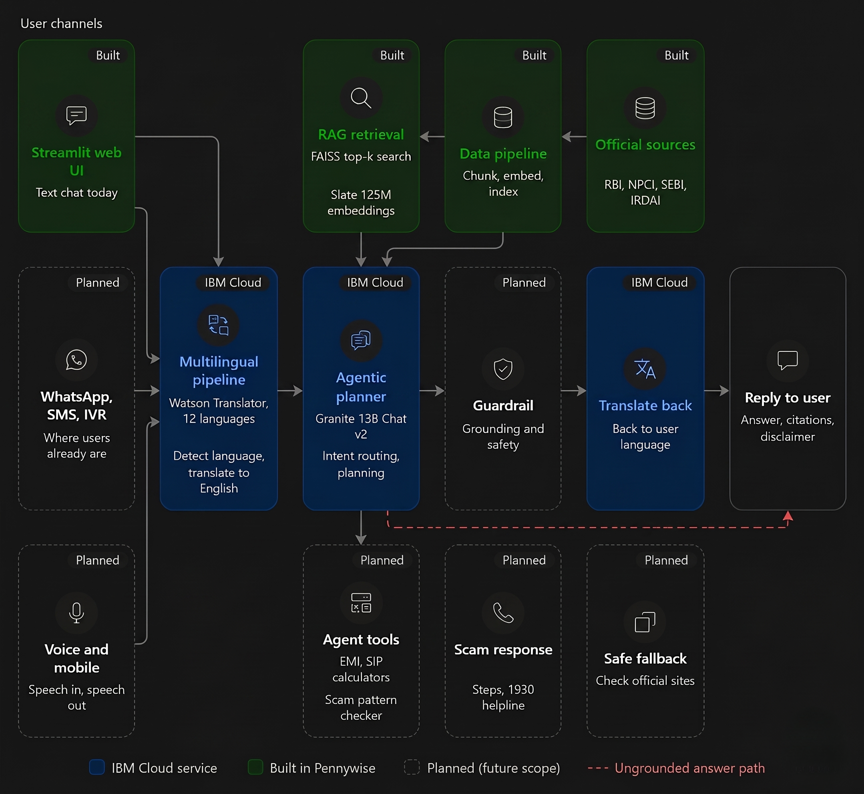
Architecture blueprint

Slide 7
Role of Agentic AI in the solution
What the agent does now
Perceives: Detects the user’s language and script.
Plans the workflow: chooses the steps needed for a query (translate, retrieve, generate, translate back).
Acts through tools: calls IBM Watson Language Translator, the FAISS knowledge base, and IBM Granite on WatsonX.ai.
Stays grounded: answers only from retrieved RBI, NPCI, SEBI and IRDAI content, with a disclaimer pointing to official sources.
Intent routing: the agent classifies a question (UPI how-to, scam check, loan advice, budgeting) and picks the right retrieval strategy or tool for it.
Multi-step reasoning: a question like “Can I afford a ₹5 lakh loan on ₹30k/month?” is broken into sub-tasks: explain interest rates, compute EMI, apply the 50-30-20 rule, and flag predatory lender signs.
Self-checking: the agent verifies whether retrieved context actually supports its answer, and says “I don’t know, please check rbi.org.in” instead of guessing.
Proactive protection: when a user describes a suspicious call, OTP request, or QR code, the agent moves from explaining to acting. It walks them through blocking the number, contacting their bank, and reporting to 1930 / cybercrime.gov.in.
Memory and personalization: it remembers the user’s language, literacy level, and goals across a session, so it can build on earlier answers instead of repeating itself.
Tool use: calculators (EMI, SIP, FD maturity), live-rate lookups, and scam-pattern checkers become tools the agent calls when needed.
In short, RAG supplies the knowledge, the LLM supplies the language, and the agent supplies the decision-making that connects them.

Slide 8
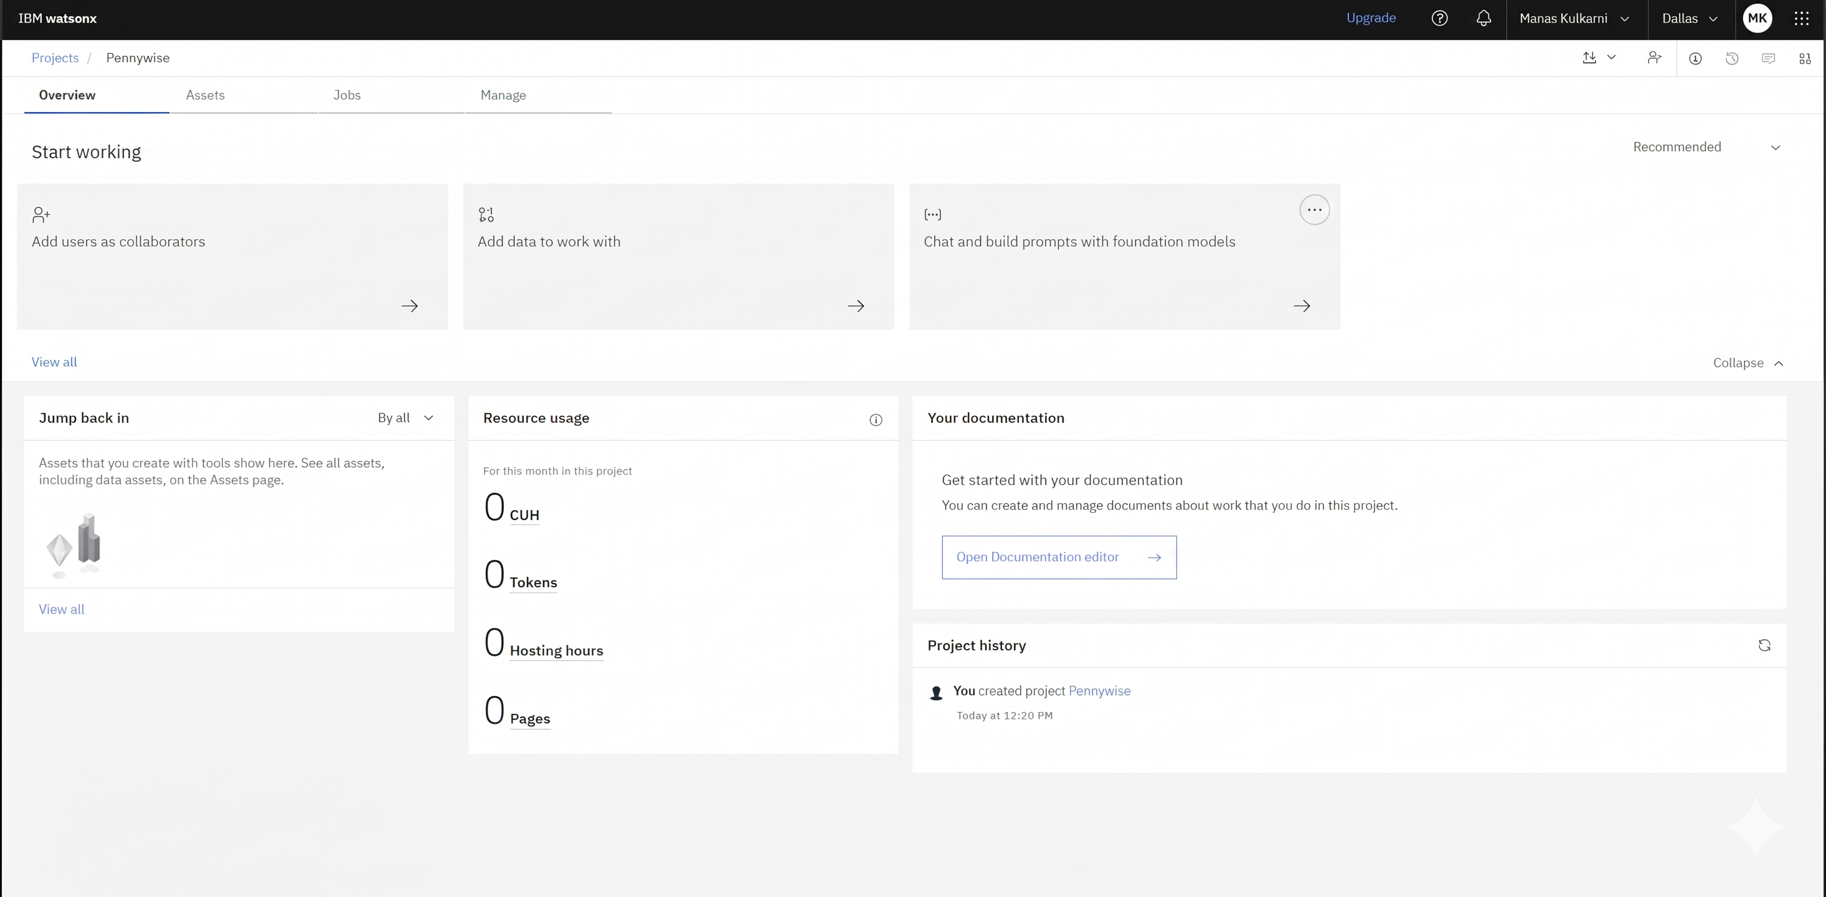
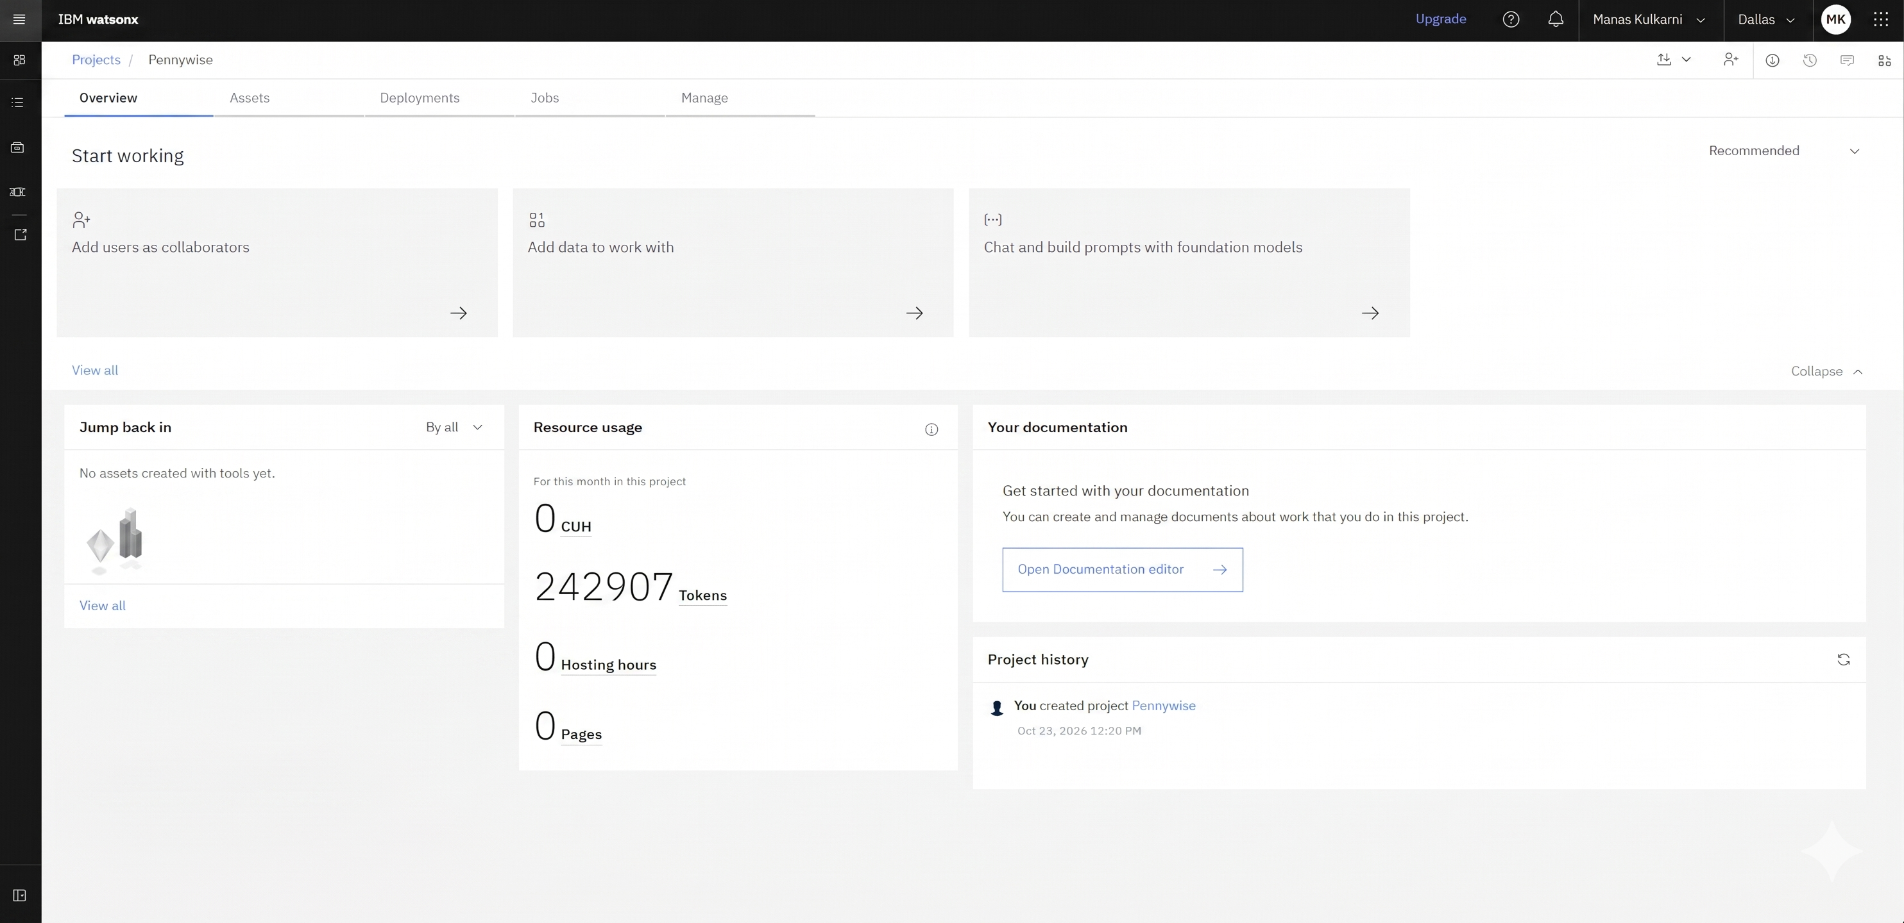
Token Usage
11,761 token are used
Before Prompt
After the Prompt
·
·
·

Slide 9
Novelty and Uniqueness
Built for India, not adapted to it. The knowledge base comes from RBI, NPCI, SEBI, IRDAI and government schemes (Jan Dhan, PPF, Ayushman Bharat), not generic global finance content. It covers India-specific topics like UPI, KYC scams, SIM swap, and CIBIL.
Multilingual by design. Twelve Indian languages are supported, including Hindi, Tamil, Telugu, Bengali, Marathi and Urdu. Queries are translated to English for retrieval, and answers are translated back, so users don’t need English to get accurate information.
Grounded instead of hallucinated. Financial misinformation is costly, so every answer is generated from retrieved, curated sources. This makes the system safer than a plain chatbot.
Protection plus education. Most financial literacy tools only explain concepts. Pennywise also targets fraud directly (phishing, QR scams, fake KYC) and gives actionable steps such as the 1930 helpline.
Runs entirely on the free tier. It uses IBM Granite 13B Chat v2, Slate 125M embeddings, and Watson Translator on IBM Cloud Lite, so it can be deployed and scaled by students, NGOs and small institutions at no cost.
Modular architecture. The knowledge base, translator, LLM client and agent are separate modules. New topics, languages or models can be added without rewriting the system.
Responsible AI. It states clearly that it is not a registered financial adviser and directs users to SEBI-registered advisers and official portals.

Slide 10
Git Hub Link
Working GitHub URL – https://github.com/TERMINATOR7732/Pennywise.git
Make sure you have Uploaded following three files into your GitHub repository
1) app.py file :Pennywise/app.py at master · TERMINATOR7732/Pennywise
2) Problem Statement file:Pennywise/Problem Statement.png at master · TERMINATOR7732/Pennywise
3) Website Link: https://pennywise-bwxgyapp3zezipxat96suoe.streamlit.app

Slide 11
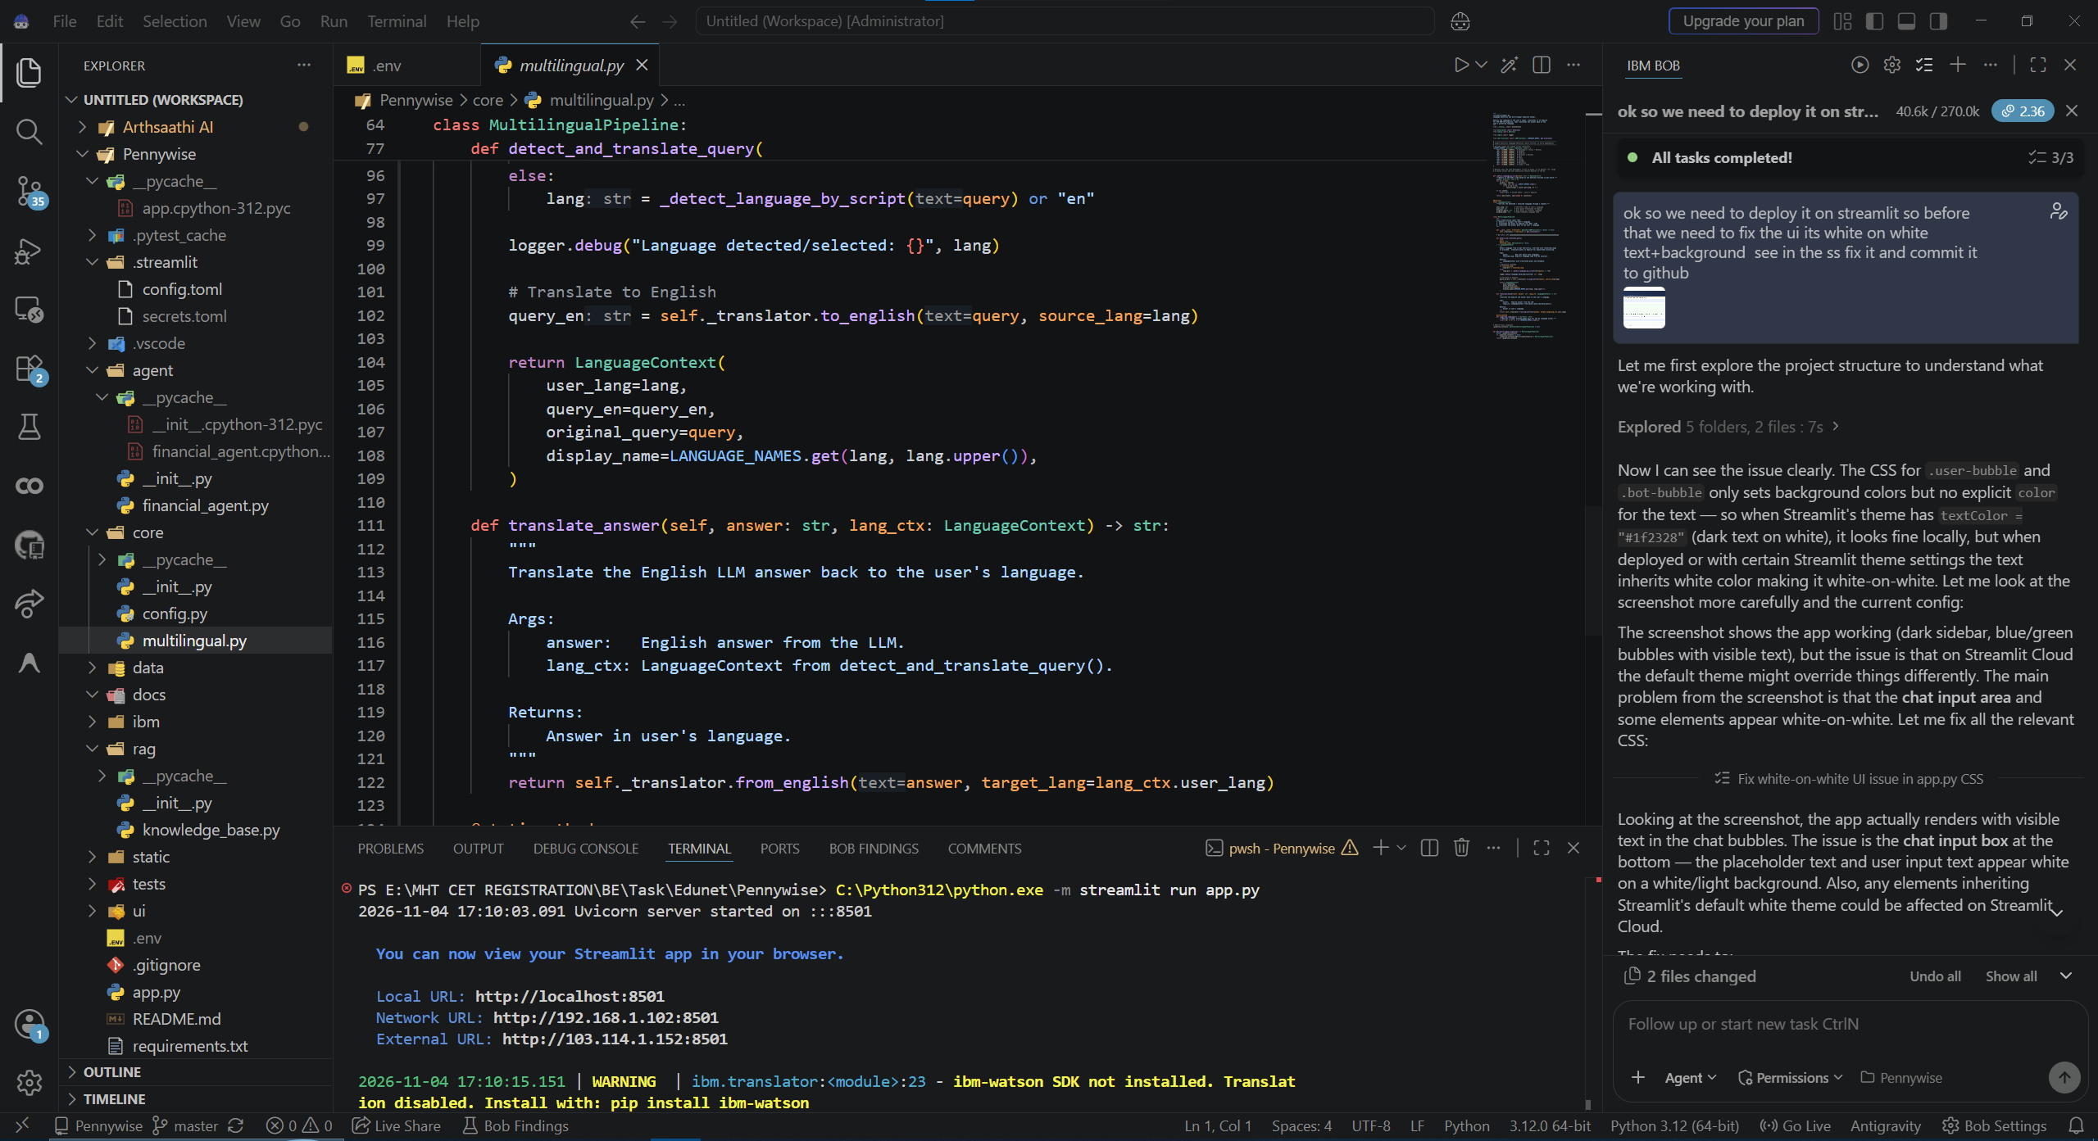
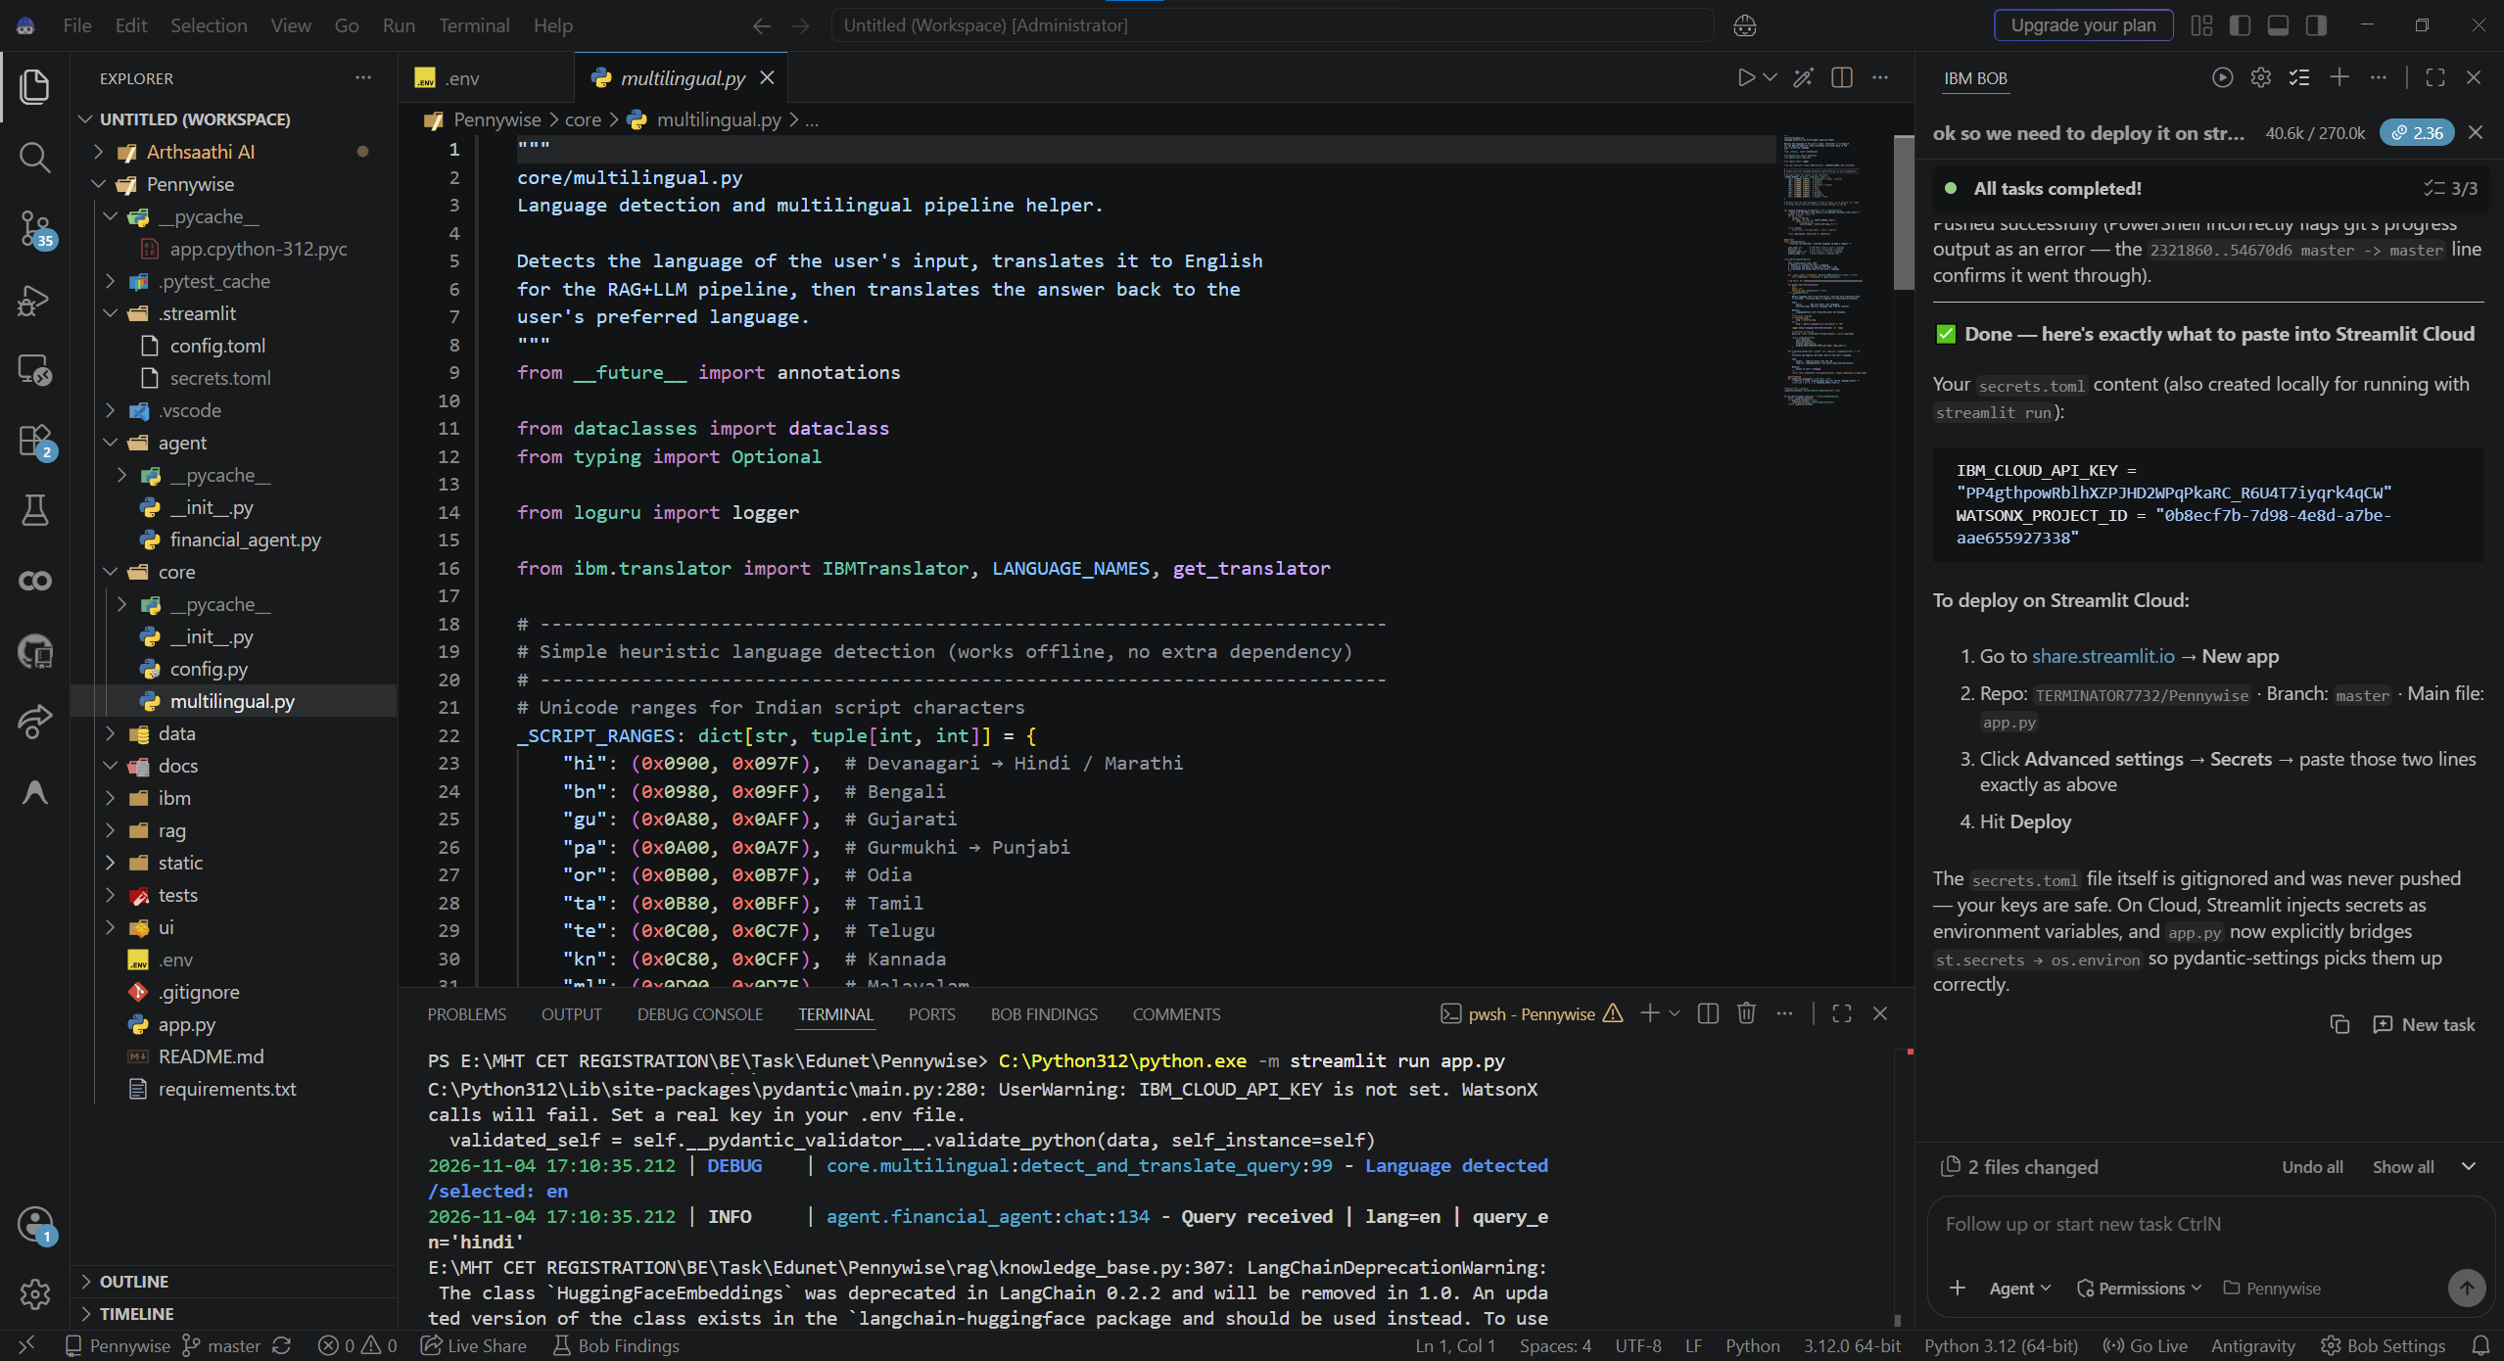
Code Snippet

Slide 12
Future Scope
Future Scope
Voice and messaging channels: Speech-to-text and text-to-speech, plus WhatsApp, Telegram and SMS/IVR access, so low-literacy and rural users can reach Pennywise where they already are, including in low-bandwidth areas and in code-mixed speech like Hinglish.
Full agentic workflows: Tool calling for EMI, SIP and FD calculators, loan comparison, budget planning and CIBIL guidance, along with personalised coaching that tracks goals and adapts learning paths to each user’s level.
Real-time scam and document analysis: Users can paste or photograph a suspicious message, link or QR code to get a risk assessment, or upload a loan agreement, insurance policy or bank statement to get a plain-language explanation that flags hidden charges.
Fresh, trustworthy knowledge: Automated ingestion of new RBI circulars, SEBI notices and scheme updates, source citations in every answer, hallucination checks, and upgrades to newer IBM Granite models for better reasoning and multilingual quality.
Ecosystem integration and scale: Embedding Pennywise as an in-app help assistant in bank apps, UPI apps and government portals, partnering with schools, SHGs and NGOs for literacy campaigns, and offering an analytics dashboard of common questions and scam trends for banks and regulators. Privacy stays central, with no storage of personal financial data and consent-based memory.

Slide 13
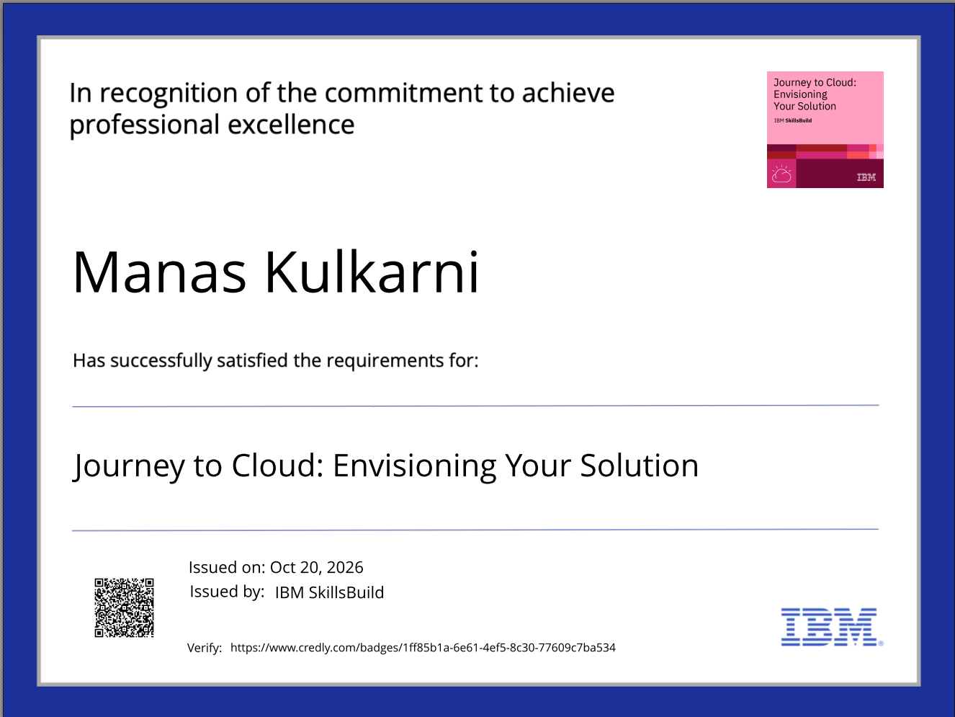
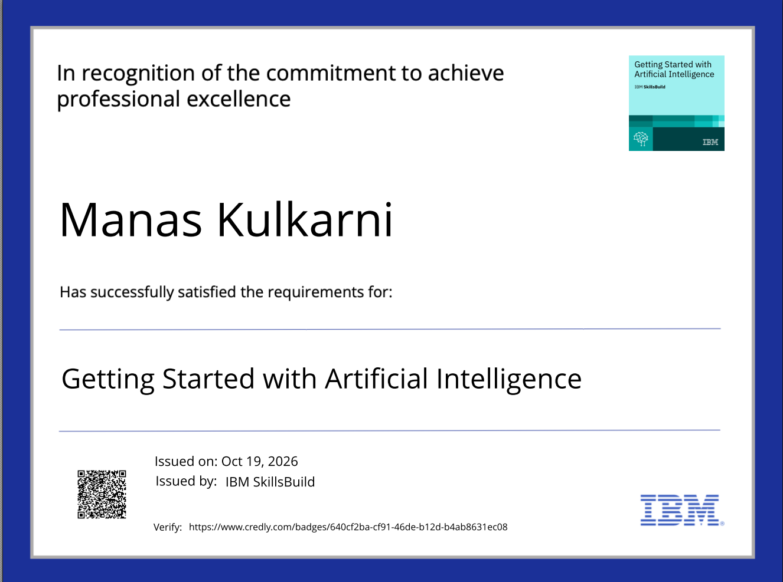
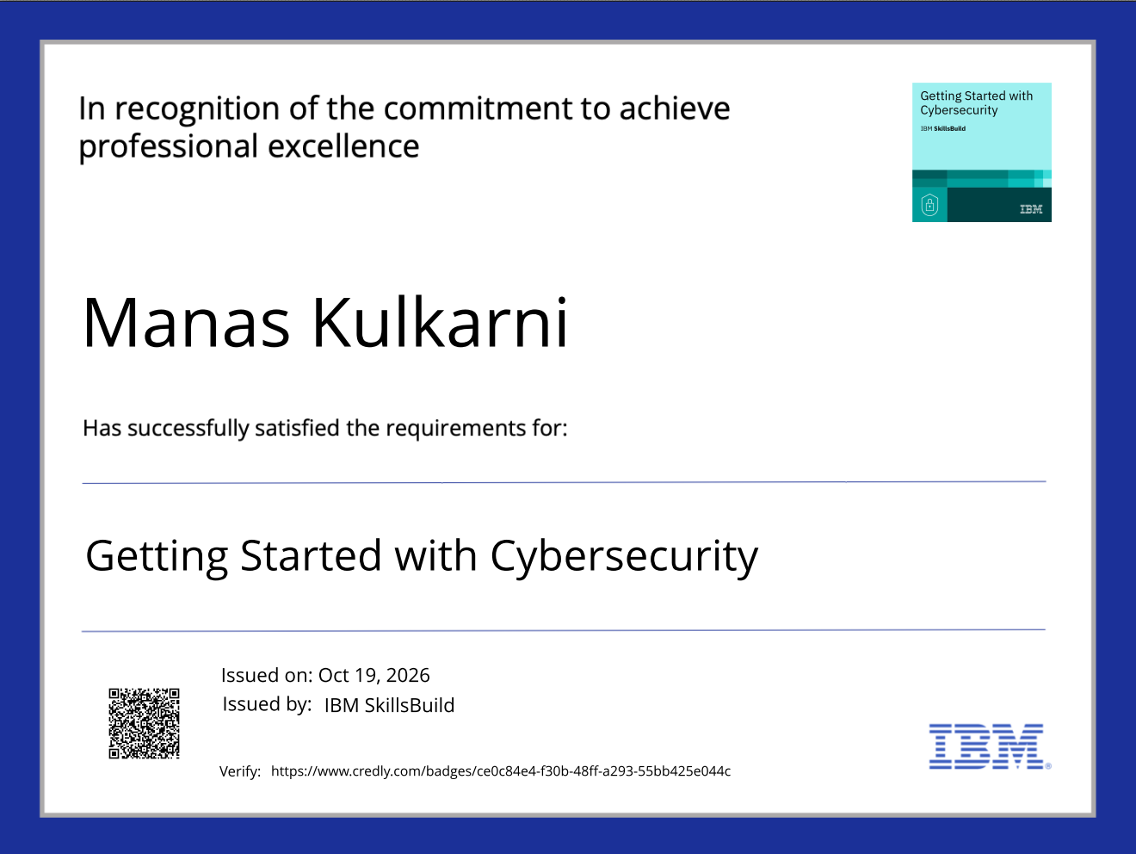
Certificates Earned:

Slide 14
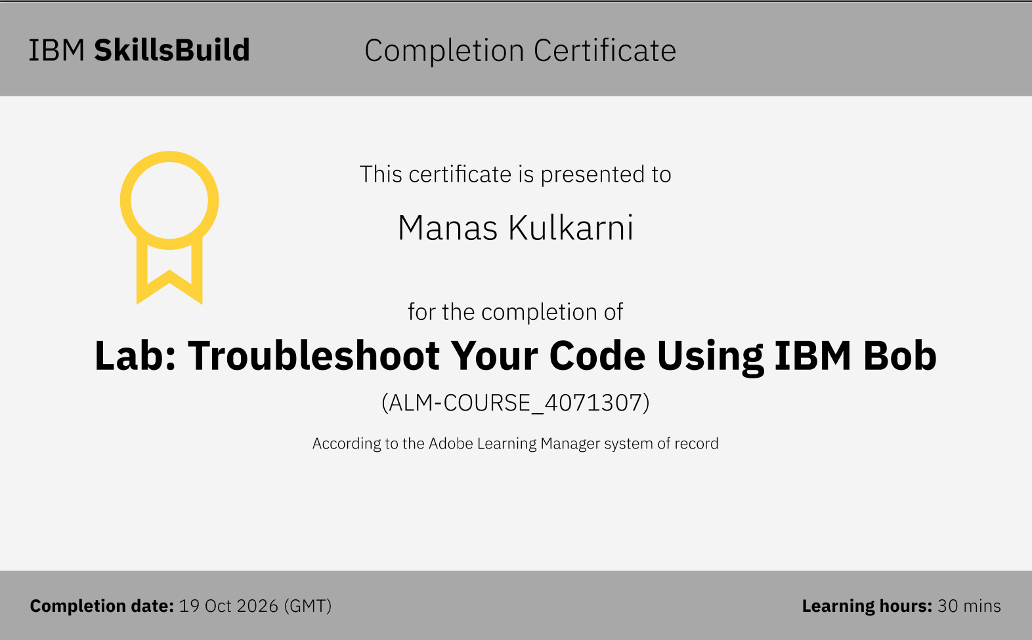
Certificates Earned:​
Add your IBM BOB Certificate

Slide 15


